Slide 1
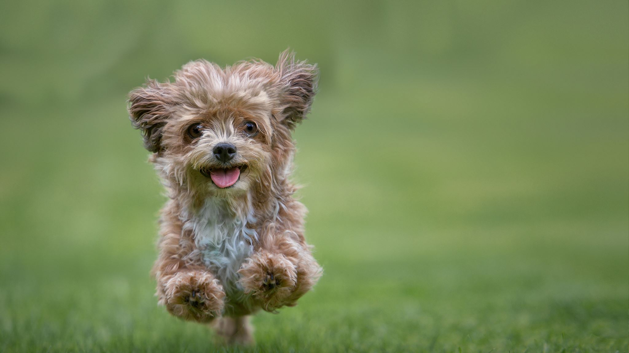
google Meet
How to Power point

Slide 2
Rules for a Google Meeting
Arrive on time with your microphone muted
Be in a quiet place with minimal distraction (no TV or video games in the background)
Remember to be respectful
The chat bar can be seen by everyone in the meeting and is to be used for questions.
If you have a question please either write your question in the chat bar or write Q and when I unmute your mic you can ask your question to the group.
I will be recording every Google Meeting

Slide 3
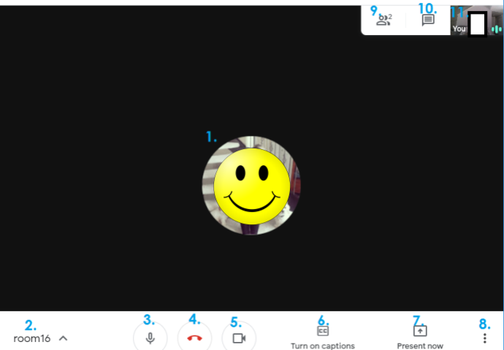
Walk through
1 = the person talking/presenting
2 = meeting name
3 = turn mic on & off
4 = exit meeting
5 = turn your camera on & off
6 = close captions
7 = you present your screen
(leave that alone please)
8 = more options
9 = group members
10 = group chat
11 = your camera

